Slide 1
CS 435: Algorithms
Dynamic Programming:
Emdad Khan 1 7/8/15

Slide 2
Dynamic Programming - Basics
Dynamic Programming is a general algorithm design technique
for solving problems defined by or formulated as recurrences with overlapping subinstances
Invented by American mathematician Richard Bellman in the 1950s to solve optimization problems and later assimilated by CS
“Programming” here means “planning”
Main idea:
    set up a recurrence relating a solution to a larger instance to solutions of some smaller instances
    - solve smaller instances once
    record solutions in a table
    extract solution to the initial instance from that table

Slide 3
Dynamic Programming - Basics
Similar to Divide and Conquer
However, Divide and Conquer uses non-overlapped sub-problems whereas DP uses Overlapped sub-problem.
Use of Divide & Conquer will result many unnecessary computations as sub-problems are overlapped.
DP saves computations in each iteration which can be used in the next iteration. – thus saves computation time BUT at the cost of more memory!

Slide 4
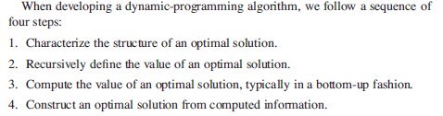
Key Steps in DP

Slide 5
Example: Fibonacci numbers
Recall definition of Fibonacci numbers:
  F(n) = F(n-1) + F(n-2)
  F(0) = 0
  F(1) = 1
Computing the n^{th} Fibonacci number recursively (top-down):
F(n)
F(n-1) + F(n-2)
F(n-2) + F(n-3) F(n-3) + F(n-4)
...

Slide 6
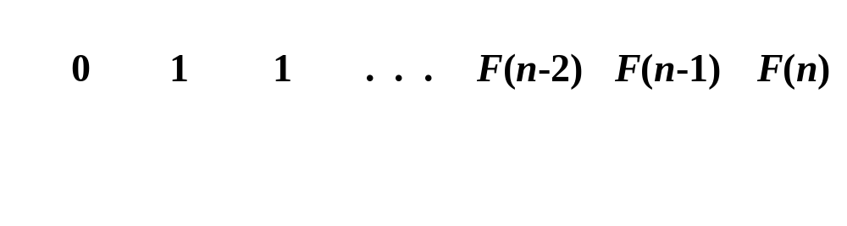
Example: Fibonacci numbers (cont.)
  Computing the n^{th} Fibonacci number using bottom-up iteration and recording results:
F(0) = 0
F(1) = 1
F(2) = 1+0 = 1
…
F(n-2) =
F(n-1) =
F(n) = F(n-1) + F(n-2)
Efficiency:
- time
- space
n
n

Slide 7
Examples of DP algorithms
Computing a binomial coefficient
Longest common subsequence
Warshall’s algorithm for transitive closure
Floyd’s algorithm for all-pairs shortest paths
Constructing an optimal binary search tree
Some instances of difficult discrete optimization problems:
  - traveling salesman
  - knapsack

Slide 8


Rod Cutting Problem

Slide 9
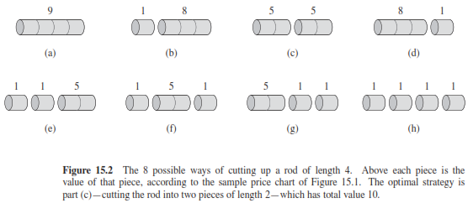
Rod Cutting Problem

Slide 10


Rod Cutting
A decomposition is denoted into pieces using

Slide 11
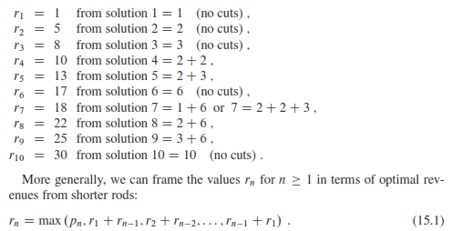
Rod Cutting Problem

Slide 12
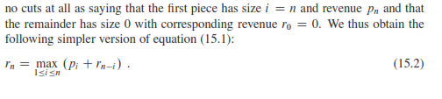
Rod Cutting
The first argument means NO Cut at all.
The other arguments means cutting the rod into TWO pi eces of size I and n-i. AND then Optimally Cut ing those pieces further.
An equivalent scheme is to consider subdividing the rod into I and n-I with I the left decomposition and n-I the right decomposition. We then just subdivide the right side only (consider i=n etc). Thus solution with this is like

Slide 13
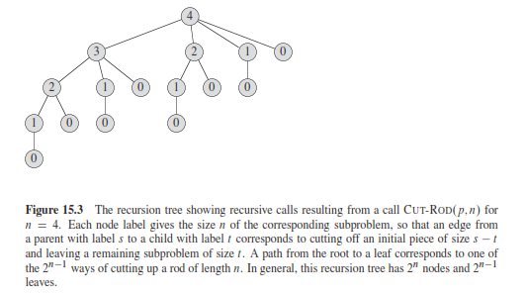
Rod Cutting
Recursion Tree

Slide 14
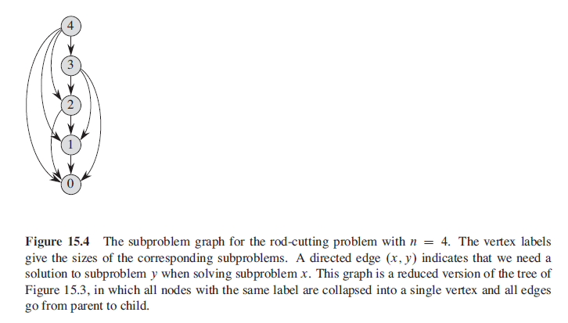
Rod Cutting
Recursion Tree

Slide 15
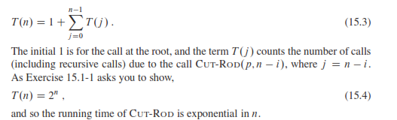
Rod Cutting – Running Time
Running Time (Dynamic Programming will make it lot better)

Slide 16
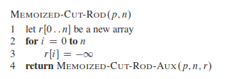
Rod Cutting
There are TWO ways with DP and associated space for memory (called Memoisation) – Top Down and Bottom Up
Key concept– solve the sub-problem once (not repeatedly as with Divide & Conquer) and store the result in a table.
Use the already computed result again etc.
First – the Top Down

Slide 17
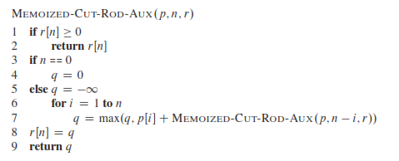
Rod Cutting – Top down
It is basically Memoised version of Cut-Rod

Slide 18
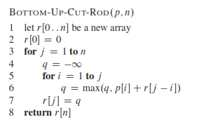
Rod Cutting – Bottom-up
Bottom-up version is even simpler

Slide 19
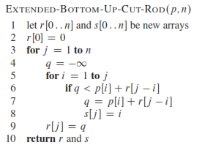
Rod Cutting – Reconstruction
The solutions shown so far produces the optimized value but NOT the solution itself i.e. not the specific cuts that were used to get the optimal revenue or value.
Reconstruction will provide both value and the sizes for the optimal solutions.

Slide 20
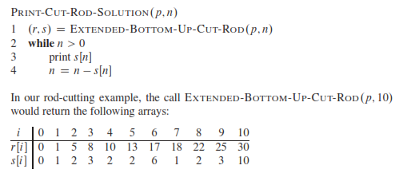
Rod Cutting – Reconstruction
Extended Bottom-up solution

Slide 21

Rod Cutting – Reconstruction
Printed Solution

Slide 22
Computing a binomial coefficient by DP
  Binomial coefficients are coefficients of the binomial formula:
  (a + b)^{n} = C(n,0)a^{n}b⁰ + . . . + C(n,k)a^{n-k}b^{k} + . . . + C(n,n)a⁰b^{n}
  Recurrence: C(n,k) = C(n-1,k) + C(n-1,k-1) for n > k > 0
  C(n,0) = 1, C(n,n) = 1 for n ≥ 0
  Value of C(n,k) can be computed by filling a table:
  0 1 2 . . . k-1 k
  0 1
  1 1 1
  .
  .
  .
  n-1 C(n-1,k-1) C(n-1,k)
  n C(n,k)

Slide 23
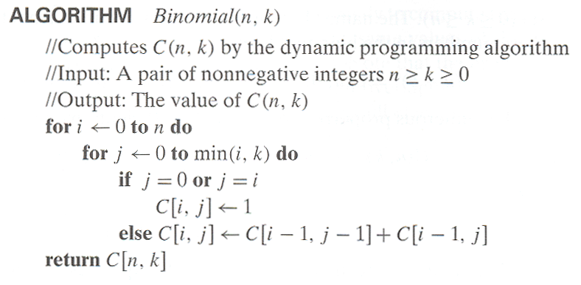
Computing C(n,k): pseudocode and analysis
Time efficiency: Θ(nk)
Space efficiency: Θ(nk)

Slide 24
Properties of a problem that can be solved with dynamic programming
Simple Subproblems
  - We should be able to break the original problem to smaller subproblems that have the same structure
Optimal Substructure of the problems
  - The solution to the problem must be a composition of subproblem solutions (subproblem itself needs to be optimal)
Subproblem Overlap
  - Optimal subproblems to unrelated problems can contain subproblems in common
Emdad Khan 1 3/10/2013

Slide 25
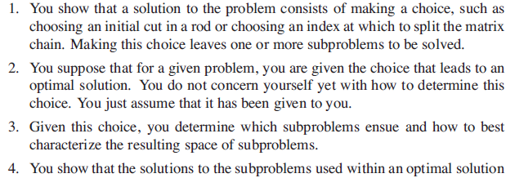
Discovering Optimal Substructure
Emdad Khan 1 3/10/2013

Slide 26
0-1 Knapsack Problem
Given a knapsack with maximum capacity W, and a set S consisting of n items
Each item i has some weight w_{i} and benefit value b_{i} (all w_{i} , b_{i} and W are integer values)
Problem: How to pack the knapsack to achieve maximum total value of packed items?
Emdad Khan 1 3/10/2013

Slide 27
Knapsack Problem by DP
Given n items of
  integer weights: w₁ w₂ … w_{n}
  values: v₁ v₂ … v_{n}
a knapsack of integer capacity W
find most valuable subset of the items that fit into the knapsack
Consider instance defined by first i items and capacity j (j ≤ W).
Let V[i,j] be optimal value of such an instance. Then

Slide 28
Knapsack Problem by DP
max {V[i-1,j], v_{i} + V[i-1,j- w_{i}]} if j- w_{i} ≥ 0
V[i,j] =
V[i-1,j] if j- w_{i} < 0
Initial conditions: V[0,j] = 0 and V[i,0] = 0

Slide 29
Knapsack Problem -Example
Item | a | b | c | d | e
Benefit | 15 | 12 | 9 | 16 | 17
Weight | 2 | 5 | 3 | 4 | 6
The maximum allowable total weight in the knapsack is Wmax = 12.
 | 1 | 2 | 3 | 4 | 5 | 6 | 7 | 8 | 9 | 10 | 11 | 12
a | 0 | 15 | 15 | 15 | 15 | 15 | 15 | 15 | 15 | 15 | 15 | 15
b | 0 | 15 | 15 | 15 | 15 | 15 | 27 | 27 | 27 | 27 | 27 | 27
c | 0 | 15 | 15 | 15 | 24 | 24 | 27 | 27 | 27 | 36 | 36 | 36
d | 0 | 15 | 15 | 16 | 24 | 31 | 31 | 31 | 40 | 40 | 43 | 43
e | 0 | 15 | 15 | 16 | 24 | 31 | 31 | 32 | 40 | 40 | 43 | 48

